Slide 1
The crossroads of Northeast Indiana Downtown Waterloo Heritage District Plan April 17, 2018

Slide 2
Project Team
Emily Hepworth
Brandon Kendera
Logan Lane
Nathan Schall
Anton Schauerte
Nathaniel Simmons
Steven Stransky
Michael Burayidi, PhD – Professor

Slide 3
Planning Process
1. Community Analysis
6. Feedback and Monitoring
2. Key Findings
5. Implementation
3. Alternative Strategies
4. Action Plan
Notes:
Downtown audit, ESRI analysis of community information, community survey that over 350 people took, studies of model communities,

Slide 4
Planning Process
1. Community Analysis
6. Feedback and Monitoring
2. Key Findings
5. Implementation
3. Alternative Strategies
4. Action Plan
Notes:
Here we are today. We proposed initiatives with strategies for implementation. After this meeting and your input, we will be revising these into an action plan that will be sent to the Town in a few weeks.

Slide 5
Planning Process
1. Community Analysis
6. Feedback and Monitoring
2. Key Findings
5. Implementation
3. Alternative Strategies
4. Action Plan
Notes:
This is your process.

Slide 6
Planning Process - Methodology
1. Review of Existing Documents
2. Field Study
3. Public Forum
4. ESRI Community Analysis
5. Community Survey

Slide 7
Key Findings from Community Forum and Student Essays
Desire for increase in local businesses (retail and restaurants)
Diversification of downtown economic activity, particularly niche businesses
Importance of making the downtown pedestrian friendly
Need for public gathering spaces and community amenities
Emphasis on uniqueness
Capitalize on the train depot for redevelopment of the downtown
Attraction of more traffic off I-69
Notes:
Take more time here explaining people concerns

Slide 8
Key Findings from ESRI Analysis
The town is losing $12 million every year to the nearby communities in retail business shopping.
Most of the leakage is from motor vehicle and parts, food and beverage, general merchandise, building materials, and health and personal care.
Notes:
2 million dollar municipal budget

Slide 9
Key Findings from Community Survey
Favorite Downtown Features
Restaurants
Historic Charm
Walkability
Desired Physical Features
Improved Landscaping
Event Space
Public Art
Establishments to Expand
Restaurants
Grocery Store
Downtown Shopping
Favorite Aspects DT Waterloo
Train Depot
Library
Park
Least Favorite Aspects
Vacant/Abandoned Buildings
Run-down
Main Expenditures Outside Waterloo
Grocery
Clothing
Household Items
Desired Events
Farmers’ Market
Festivals
Summer Movie Nights
Main Services Outside Waterloo
Medical
Automotive
Banking
Notes:
To summarize our findings, the community survey was quite insightful for us and will provide us guidance when creating your downtown plan. By indicating favorite downtown features, events, and amenities, we can use the input from the community to create a downtown catered to your vision. Some advice included the presence of restaurants, local shopping, event spaces, and other features to make Waterloo both attractive and unique. Further, guidance on how you spend your money and how often you visit Waterloo will allow my colleagues and I to pinpoint certain areas of commerce and professional services, especially grocery and medical access. Again, we want to thank those who completed a survey.

Slide 10
Vision
Waterloo’s downtown will be an aesthetically pleasing and unique regional gathering place that provides connectivity, cultural amenities, and specialty businesses to visitors and residents in a historic setting.

Slide 11
The Plan
Part 1: Design
Part 2: Policy
Part 3: Regulations
Notes:
Ordinances, guidelines

Slide 12
Part 1:
Design

Slide 13
Design Initiatives
Gateway Signs
Streetscaping
Complete Streets
Trail Extension
Trail Depot
Community Center
Business Incubator Space
Grocery Store/Bodega
Community Meeting Room
Space for Seniors
Cafe
Children’s Game Room
Community Amenities
Movie Nights
Farmers’ Market
Dog Park
Community Swimming Pool
Public Art
Train Car Gallery
Downtown Gallery
Notes:
Making the first impression is very important to visitors and residents. Complete Streets is transforming the urban core and that is why these two initiatives are mentioned first and have the highest priority.

Slide 14
Proposal 1: Gateway Signs
Located at entry points into town for all four cardinal directions
Notify visitors of their arrival in Waterloo
Welcome residents home
Establish ‘sense of place’
Include display of town’s name, motto, logo, year of establishment
May also include board with information on local/community events

Slide 15
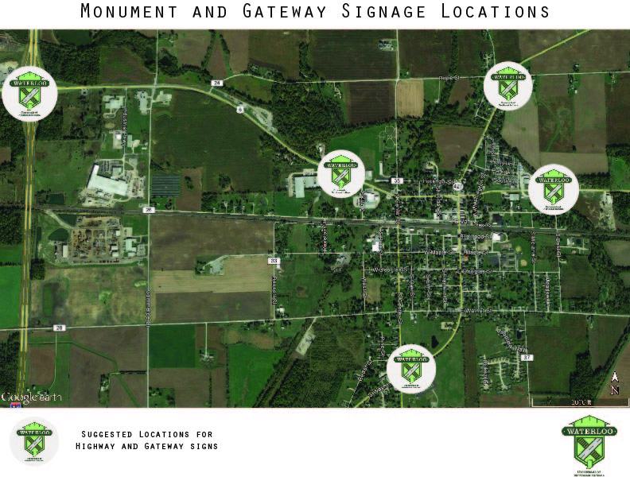
Proposal 1: Gateway Signs

Slide 16
US 6 – Gateway Sign Western Gateway
Current
Proposed

Slide 17
Highway 427 and Swartz Ditch - Gateway Sign Southern Gateway
Current
Proposed

Slide 18
Highway 427 and Rope Street – Gateway Sign Northern Gateway
Current
Proposed

Slide 19
Costs, Partners, and Priority
Project Component | Community Partner(s) | Cost | Fund Source | Priority
Monument Sign & Gateway Signs | Town of Waterloo, Northeastern Indiana Regional Coordinating Council, Indiana Department of Transportation, Indiana Department of Culture & Tourism | $200,000 (Monument Sign) $8,000 - $30,000 (per Gateway Sign) | Municipal Bonds, General Revenue Funds, Redevelopment Commission, CDBG funds, Ind. Dept. of Culture and Tourism grants/funding | High

Slide 20
Proposal 2: Streetscaping Complete Streets, Trail Extension, and Trail Depot
Complete Street will take place on Wayne Street from US-6 to existing Auburn-Waterloo Trail
Goals:
Create a downtown corridor that provides space for multi modal transportation
Makes the downtown pedestrian friendly and safe
Makes it aesthetically-pleasing to visit and stay
Increase foot traffic and demand for downtown businesses

Slide 21
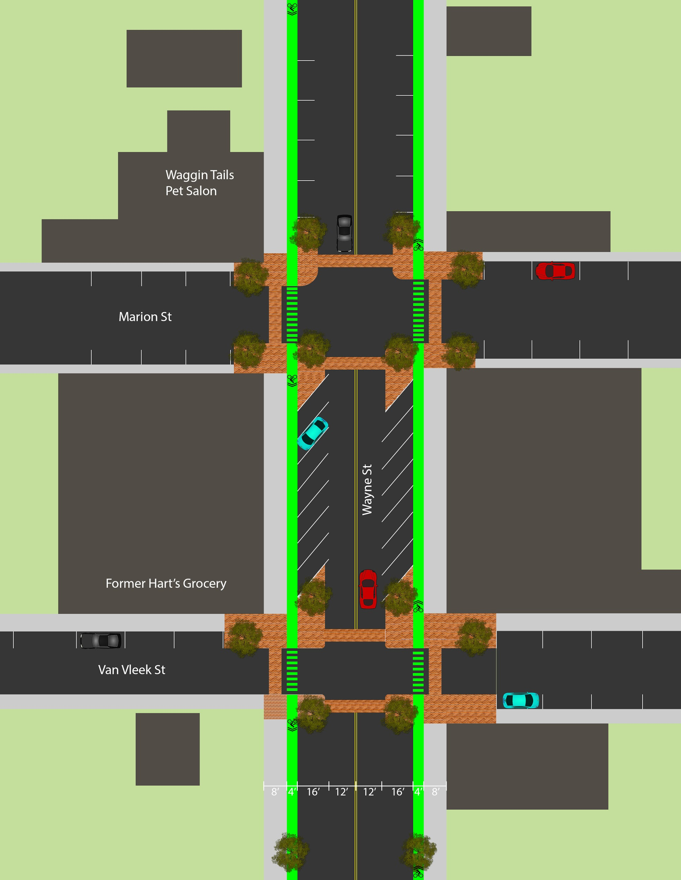
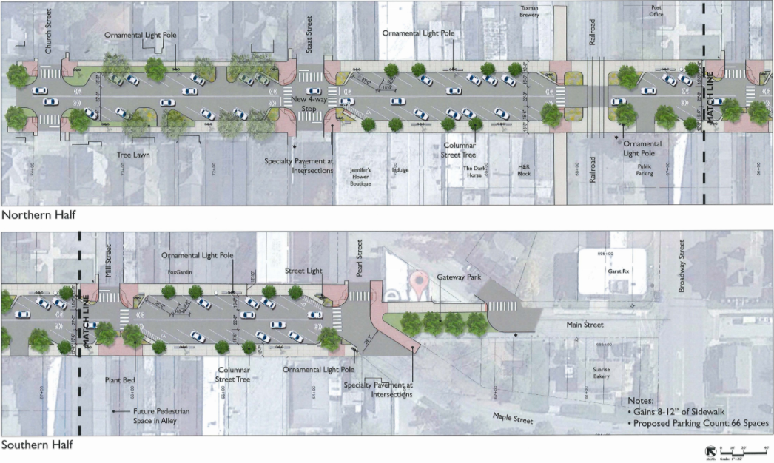
Wayne Street Redesign Proposal
30 degree angled parking
Bike lanes, street trees
Curb bump-outs
Brick paving materials

Slide 22
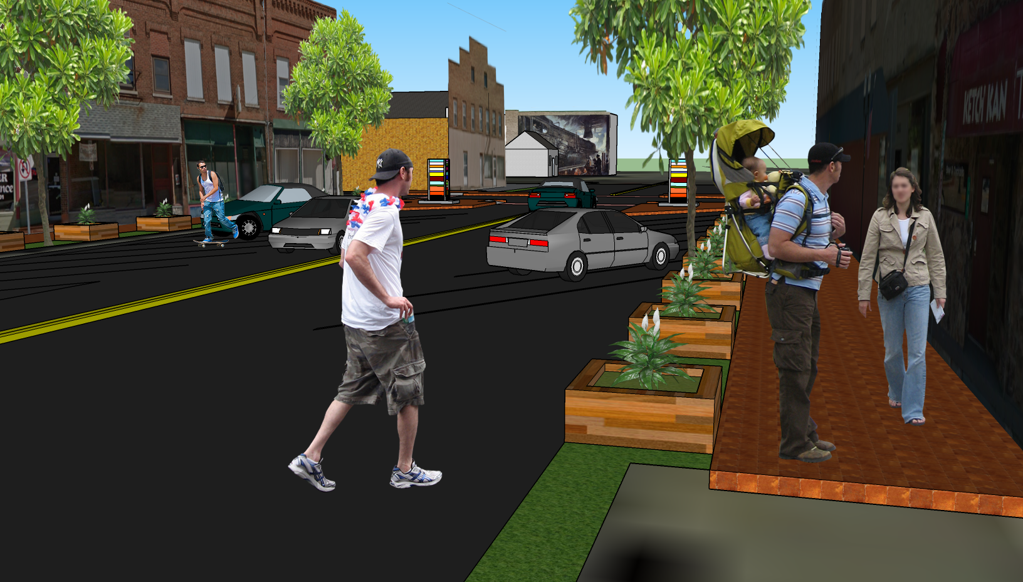
Wayne Street Redesign Proposal

Slide 23
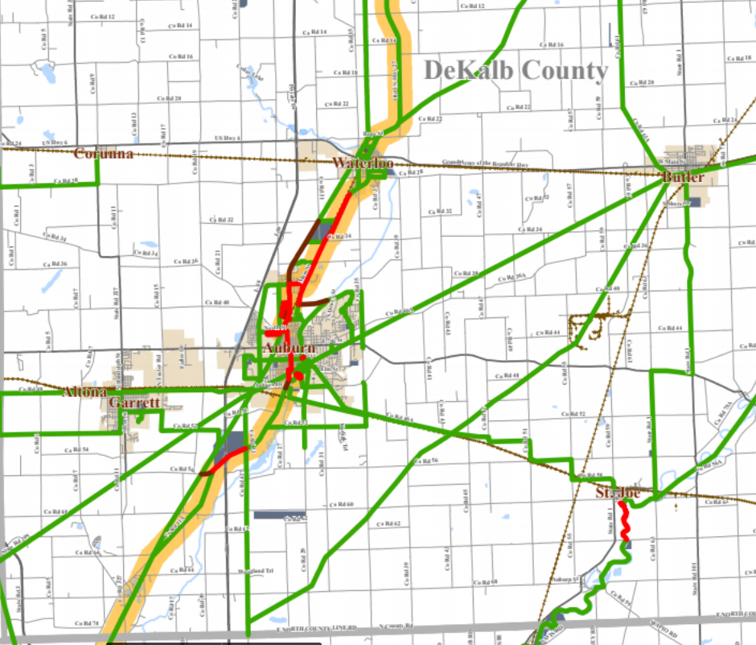

Slide 24
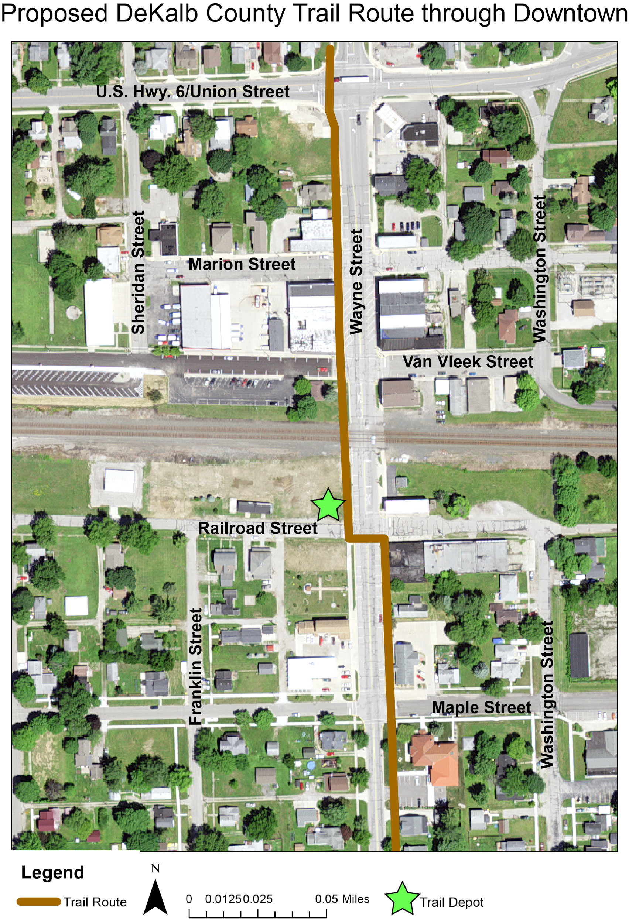
Proposed DeKalb County Trail Route through Downtown
Trail Depot at the corner of Railroad and Wayne Streets
Poka-Bache Connector

Slide 25
Trail Depot Corner of S. Wayne and W. Railroad Streets
Current
Proposed

Slide 26
Costs, Partners, and Priority
Project Component | Community Partner(s) | Cost | Fund Source | Priority
Streetscaping, Complete Streets, Trail Expansion, Trail Depot | Town of Waterloo, Northeastern Indiana Regional Coordinating Council, Indiana Department of Transportation, Waterloo Main Street, Inc. | TBD | Municipal Bonds, General Revenue Funds, Redevelopment Commission | High

Slide 27
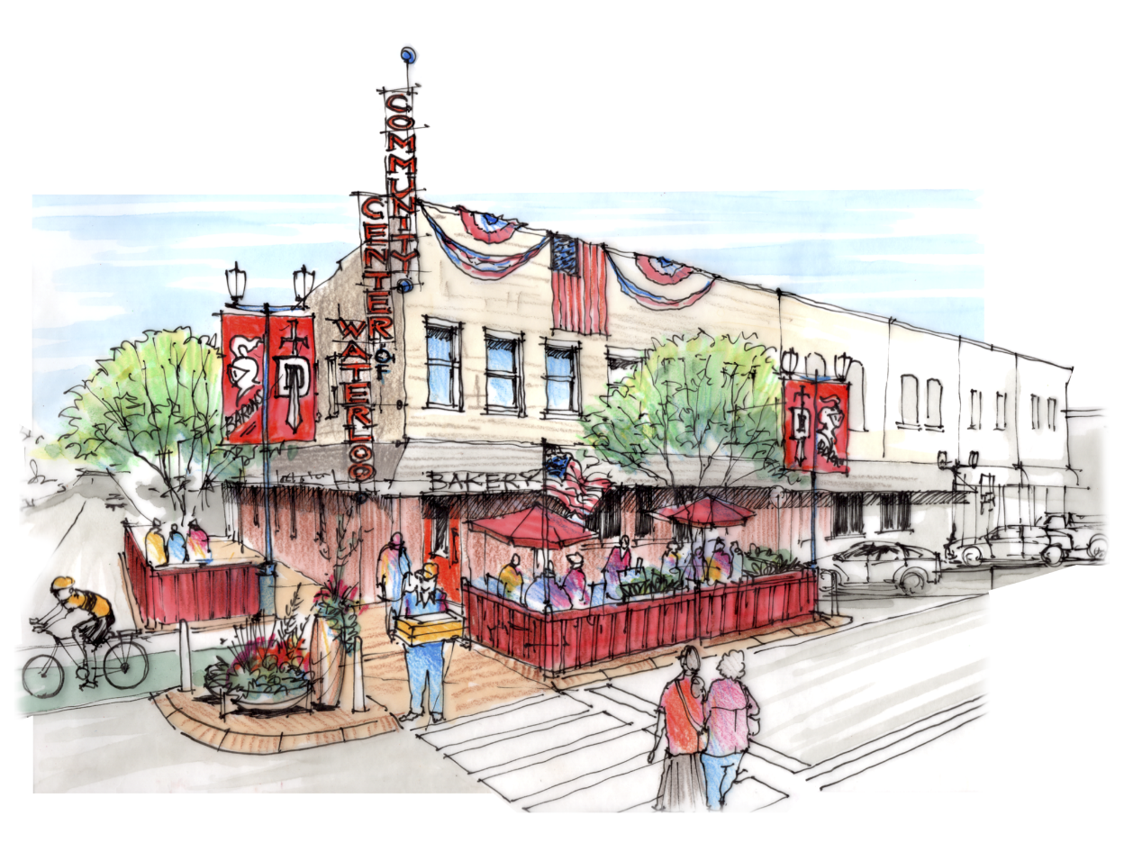
Proposal 3: Community Center
“Come on everybody! Let’s create a place that can show off all the friendly people in Waterloo. Bring a community center to our town!” - Violet S., Elementary Student
Business Incubator Space
Grocery Store/Bodega
Community Meeting Room
Space for Seniors
Cafe
Children’s Game Room

Slide 28
Hart’s Building – Community Center 205 N. Wayne Street
Current
Proposed
Notes:
Community center is entire block on Van Vleek Street including Gibson’s Heating and Plumbing

Slide 29
Costs, Partners, and Priority
Project Component | Community Partner(s) | Cost | Funding Source | Priority
Community Center | Town of Waterloo, DeKalb County, IEDC | $1,000,000 - $2,000,000 | General Fund, CDBG, IEDC Funds | High

Slide 30
Proposal 4: Community Amenities
Site for Movie Nights
Farmers’ Market
Dog Park
Community Swimming Pool
Public Art
Train Car Gallery
Downtown Gallery
Notes:
Community Amenities show importance of events in downtown area. Schedule as many as possible to increase foot traffic and use other amenities to improve quality of life.

Slide 31
Summer Movie Nights
Community members expressed wanting a summer movie night in the community
Summer movie nights are proposed to take place weekly during the summer months of May through August at Francis Thompson Park, using a blow up projector screen.

Slide 32
Goals
A summer movie night is an inexpensive way to get the community together
Fulfills the need for more activities in the downtown area
Small events can create community cohesion

Slide 33
Thompson Park – Movie Nights West Van Vleek Street
Current
Proposed

Slide 34
Cost, Partners, and Priority
Project Component | Community Partner(s) | Cost | Funding Source | Priority
Movie Nights | Town of Waterloo - Parks Department | $5,000 | Crowdfunding, General Revenue Fund | Low

Slide 35
Farmers’ Market 285 South Wayne Street
Current
Proposed

Slide 36
Goals
Temporary food desert solution
Opportunity for small business owners to grow their business
Opportunity for local farmers to sell their goods directly to consumer

Slide 37
Costs, Partners, and Priority
Project Component | Community Partner(s) | Cost | Funding Source | Priority
Leasing | Town of Waterloo; Redevelopment Commission | TBD | Town of Waterloo; Redevelopment Commission; Crowdfunding; General Revenue Fund | High
Equipment (table/tent = booths) | Town of Waterloo; Redevelopment Commission | ~$150 per booth | Town of Waterloo; Redevelopment Commission; Crowdfunding; General Revenue Fund* *Could potentially be offset by vendor fees | High

Slide 38
Dog Park 3800 Block US 6
Current
Proposed

Slide 39
Goals
Safe gathering space for canines and their owners
Exercised dogs = good neighbors
Provides an opportunity for residents to interact

Slide 40
Ideal Dog Park Features
One acre or more of land
4-6 ft. of fencing
Double-gated entry
Water fountains
Benches
Shade opportunities
Waste disposal
Dog Play Equipment
Segregation of space for smaller dogs
Signs that specify park hours and rules
Parking close to the site

Slide 41
Costs, Partners, and Priority
Project Component | Community Partner(s) | Cost | Funding Source | Priority
Acquisition | Town of Waterloo; DeKalb County Animal Services | $8,600 | Town of Waterloo; Redevelopment Commission; Crowdfunding | Medium
Fencing | Town of Waterloo; DeKalb County Animal Services | ~$9,000 | Town of Waterloo; Redevelopment Commission; Crowdfunding | Medium
Park Equipment | Town of Waterloo; DeKalb County Animal Services | $1,700+ | Town of Waterloo; Redevelopment Commission; Crowdfunding | Medium

Slide 42
Community Swimming Pool Corner of S. Indiana St. and E. Douglas St.
Current
Proposed

Slide 43
Goals
“People LOVE swimming! It is good for your body and health. Swimming is also better for relaxing and strength, and people love relaxing!”
- Avi W., Elementary Student
Creates a gathering space for residents and area visitors
Brings outside residents into the downtown area
Fees from swimming pool can provide additional revenue
Help retain portion of $12 million leaking out of community

Slide 44
Costs, Partners, and Priority
Project Component | Community Partner(s) | Cost | Funding Source | Priority
Community Swimming Pool | Town of Waterloo Parks Board, Redevelopment Commission | TBD | Town of Waterloo; Redevelopment Commission; Crowdfunding | Low

Slide 45
Public Art
“My other reason is it will be beautiful! It’s going to be nice to look at.”
– Elizabeth L., Elementary Student
The Public Art initiative:
One gallery in an existing building downtown
One gallery in a train car by the depot
Four public art features including both murals and sculptures

Slide 46
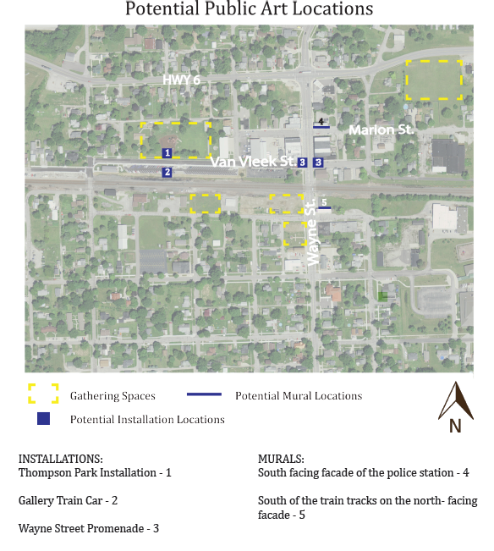
Potential Public Art Locations

Slide 47
Goals
Makes community aesthetically pleasing
Highlight community’s history and heritage
Assist in branding the community
Fosters community engagement
Engages local artists

Slide 48
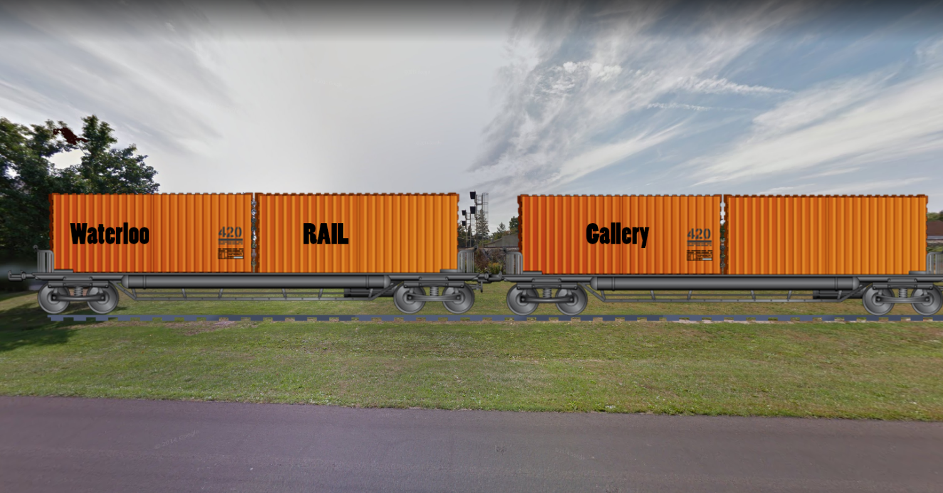
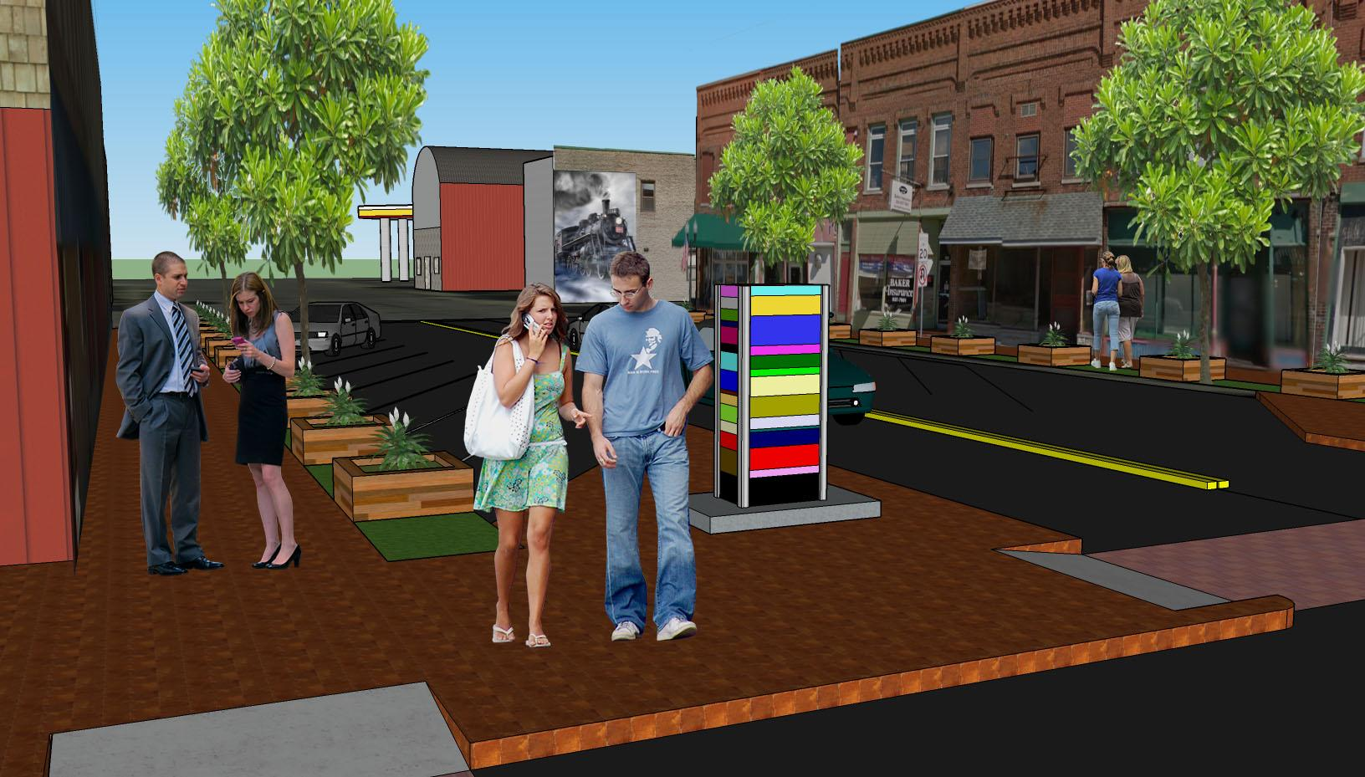
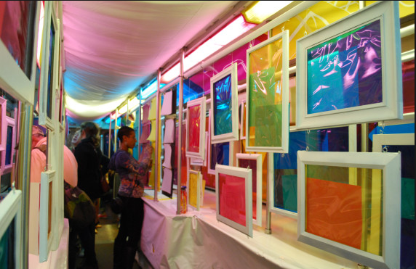
Public Art Installations

Slide 49
Costs, Partners, and Priority
Project | Community Partner(s) | Cost | Funding Source | Priority
Murals/ Installations per piece | Town of Waterloo, Auburn Arts Commission | $5,000 - $10,000 | Crowdfunding | Medium
Train Gallery | Town of Waterloo, Auburn Arts Commission | $15,000 | PBIF | Low
Downtown Gallery | Town of Waterloo, Auburn Arts Commission | $500 | Crowdfunding | High

Slide 50
Part 2:
Policy

Slide 51
Policy Initiatives
Capital Improvement Plan
Economic Development
Revolving Loan
Venture Capital
Fee Waivers (Utilities assistance)
Public Private Partnerships
Business Incubator Space
Reuse of Existing Buildings
Incentives for Restaurant and Grocery Store

Slide 52
Policy Initiative 1: Capital Improvement Plan
“We have to travel a long way to get food and it wastes our money!”
- Robby L.
Multi-year infrastructure plan which prioritizes projects, plans funding, and sets a timeline for completing capital projects
Capital projects are those which cost over $100,000 and have a lifespan of over 1 year
Capital improvement plans ensure that thorough planning is done for these large projects and gives residents and business owners the direction for the community’s development

Slide 53
Suggested Downtown Capital Projects
Project | Suggested Timeline | Suggested Priority | Possible Funding Sources
Streetscaping and Complete Streets | 3-5 years | High | Redevelopment Commission, Mainstreet Revitalization Program, General Obligation Bond
Restaurant Incubator Space | 1-2 years | Medium | USDA Rural Development grants, Specialty Crop Block Grant, SBA loans, Crowdfunding
Business Incubator Space | 1-2 years | Low | General Fund, CDBG Funds, IEDC
Community Center | 3-5 years | High | General Fund, CDBG Funds, IEDC
Swimming Pool & Splash Pad | 5-7 years | Low | General Fund, Crowdfunding, Redevelopment Commission

Slide 54
Policy Initiative 2:
Revolving Loan Fund
Goal:
Provides property and business owners with additional funds to fix up their properties
A gap financing tool used primarily for development and expansion of small businesses
Eligible uses for RLF loans include:
Facade and building renovation
Operating capital
Landscape and property improvements
Machinery and equipment
Acquisition of land and buildings
New Construction

Slide 55
Costs, Partners, and Priority
Project | Community Partners | Cost | Funding Source | Priority
Revolving Loan Fund | Town of Waterloo, Redevelopment Commission, DeKalb County Economic Development Partnership, DeKalb Chamber Partnership | $20,000 - $40,000 | General Revenue Fund, Redevelopment Commission, DeKalb County Economic Development Partnership, DeKalb Chamber Partnership | High

Slide 56
Policy Initiative 3:
Venture Capital Fund
Goals:
To help fund entrepreneurs with good ideas but limited funding availability
Can be an equity investment in a small businesses
Operate similar to micro-loan pool
Requires establishing technical assistance about the benefits and limitations about the venture capital fund

Slide 57
Venture Capital Fund
Project | Community Partner(s) | Cost | Funding Source | Priority
Venture Capital Fund | Town of Waterloo, Banks, Private Investors ("Angels"), DeKalb County Economic Development Partnership, DeKalb Chamber Partnership | $20,000 - $40,000 | Private Equity | Low

Slide 58
Policy Initiative 4:
Fee Waivers
Goals:
Help to reduce upfront costs associated with relocation to downtown, often a burden for new or relocating businesses
Assistance and waiver of fees associated with issue of permits
Waiver of fees associated with new utility connections
Partners: Town of Waterloo, utility companies

Slide 59
Policy Initiative 5:
Public-Private Partnerships
Goals:
Joint ventures between the public and private sectors
Decreases risks to the private sector from private sector only investment
Public sector’s roles include: use of eminent domain, shell buildings, and shovel ready sites
Examples of such partnerships include: swimming pool, community center, art galleries, dog park, incubator space, etc..

Slide 60
Policy Initiative 6:
Business Incubator Space
Goals:
Locate inside community center, it can help kick-start downtown Waterloo’s economy and vibrancy
Helps reduce upfront costs of opening/operating new business
Encourages collaboration between businesses/organizations occupying the space
Establishes downtown Waterloo as an innovative, business-friendly location in the region

Slide 61
Costs, Partners, and Priority
Project | Community Partner(s) | Cost | Funding Source | Priority
Business Incubator Space | Town of Waterloo, Indiana Economic Development Corporation, DeKalb County Economic Development Partnership | $50,000 - $100,000 | Town of Waterloo, Indiana Economic Development Corporation, DeKalb County Economic Development Partnership | Low

Slide 62
Policy Initiative 7:
Reuse of Existing Building (200 North Wayne Street)
Current
Proposed

Slide 63
Goals
“So again, do you remember the Green Parrot restaurant? If you do, you would have to want it to come back. Don’t let the old feelings go away. Bring back the Green Parrot!”
Joshua S., Elementary Student
Decreases blight
Remodels and repurposes existing downtown building space
Generates economic activity
Brings visitors and residents to the downtown
Responds to a community need

Slide 64
Costs, Partners, and Priority
Project | Community Partner(s) | Cost | Funding Source | Priority
Reuse of Existing Buildings | Town of Waterloo, Waterloo Main Street Inc., DeKalb Chamber Partnership, DeKalb County Economic Development, Community Foundation of DeKalb County, Redevelopment Commission | TBD | Town of Waterloo, Waterloo Main Street Inc., DeKalb Chamber Partnership, DeKalb County Economic Development, Community Foundation of DeKalb County, Redevelopment Commission | High

Slide 65
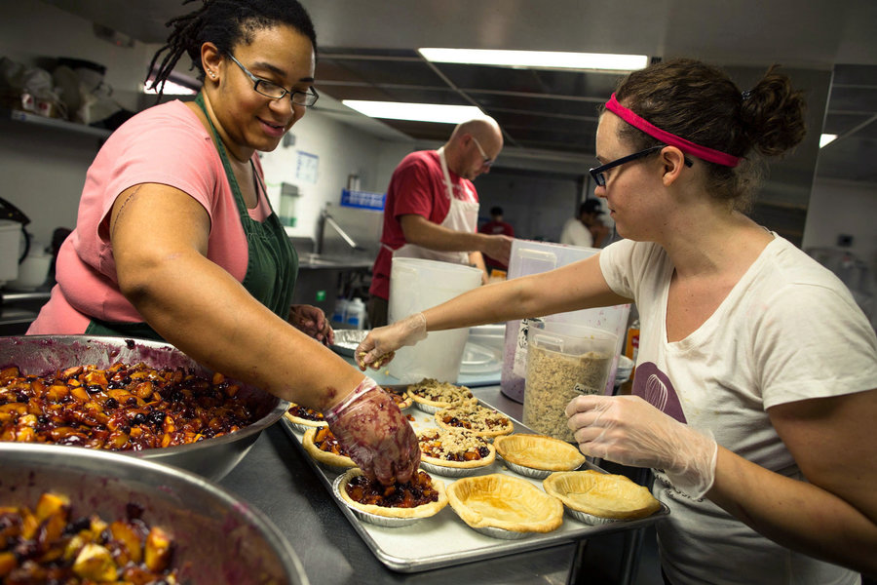
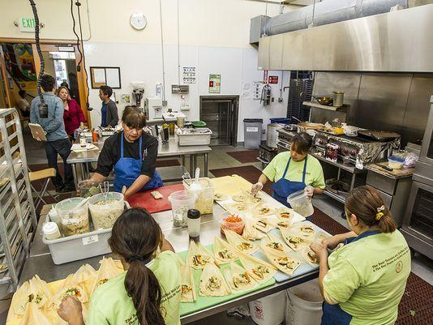
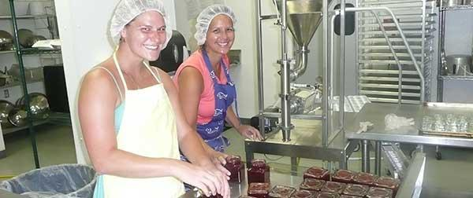
Policy Initiative 8:
Restaurant Incubator Space

Slide 66
Goals
Assist both start-up and expanding food businesses
Provide affordable building space and access to expensive equipment

Slide 67
Costs, Partners, and Priority
Project | Community Partner(s) | Cost | Funding Source | Priority
Restaurant Incubator | Town of Waterloo | $600,000 - $1.2 million | USDA Rural Development grants, Specialty Crop Block Grant, SBA loans, Crowdfunding | Medium

Slide 68
Policy Initiative 9:
Grocery Store/Restaurant Incentives
“Do you want to be healthy? Do you want to grow? Do you want to be strong? Without a grocery store in Waterloo, we can’t be all these things.”
Jasmin P., Elementary Student
Utility Assistance Grant
New Business Start-Up Incentive Grant
Rental Assistance Grant

Slide 69
Goals
Encourage restaurants/grocer to locate downtown
Reduce start-up costs
Increase diversity among downtown businesses

Slide 70
Costs, Partners, and Priority
Project | Community Partner(s) | Cost | Funding Source | Priority
Public Utility Grant | Town of Waterloo | $2,200 | General Revenue Fund, CDBG | High
New Businesses Start-Up Incentive Grant | Town of Waterloo | $3,000 | General Revenue Fund, Chamber of Commerce, CDBG | High
Rental Assistance Grant | Town of Waterloo, | $3,600 | General Revenue Fund, CDBG | High

Slide 71
Part 3:
Regulations

Slide 72
Regulatory Initiatives
Sign Ordinance
Design Guidelines
Urban Corridor Zone
Historic Preservation Guidelines

Slide 73
Sign Ordinance
Will help businesses advertise themselves in a manner that promotes local identity while preserving and promoting historic qualities
Governance of material and design quality will improve appearance of downtown
Focus on three principal sign types:
Projecting
Awning
Wall

Slide 74
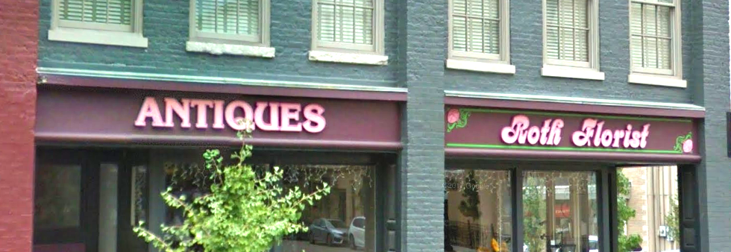
Sign Ordinance
Projecting Signs
Awning Signs
Wall Signs

Slide 75
Sign Ordinance
Suggestions (with existing signs grandparented in):
Projection signs may not be larger than 20 sq. ft.
Wall sign may not cover more than 70% of the signage area.
Awning sign may not cover more than 70% of awning space

Slide 76
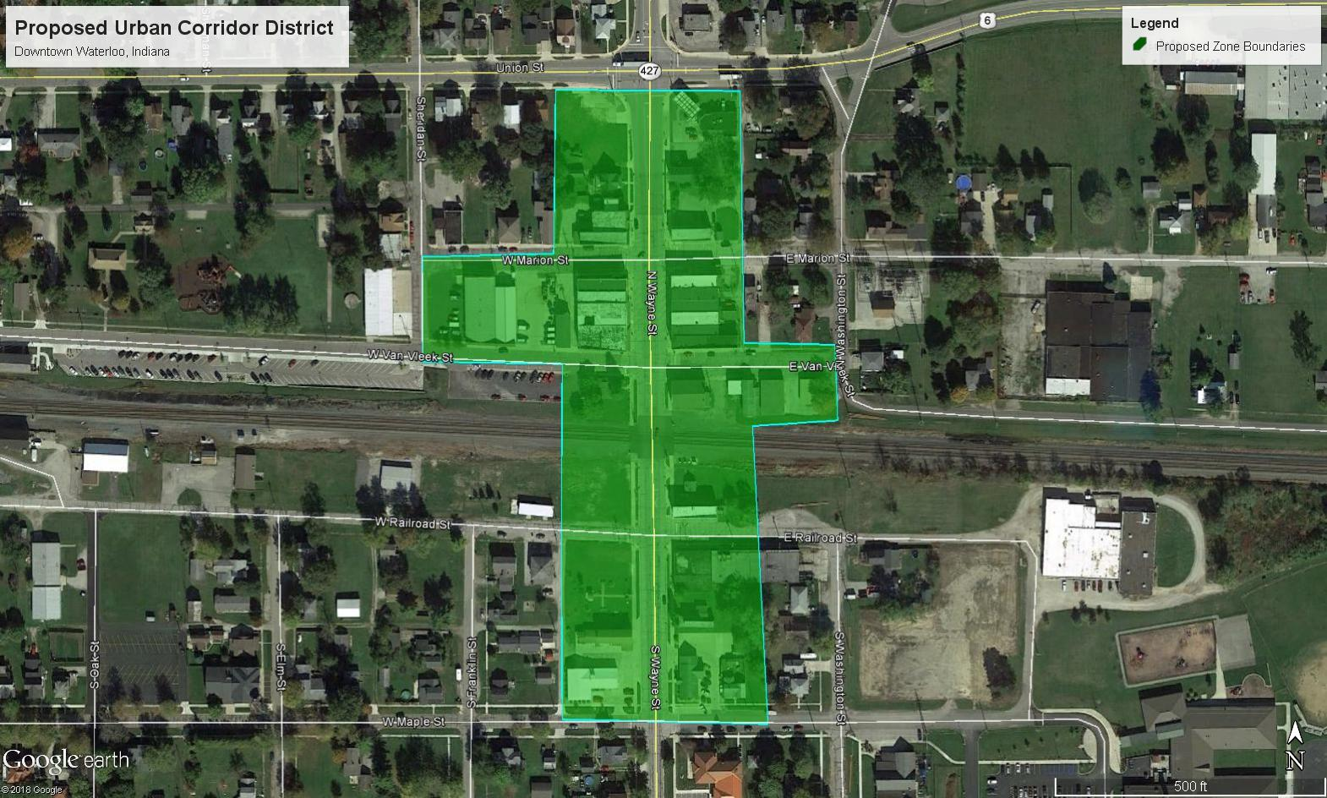
Part 1: Urban Corridor Zone
Proposed new zone to be adopted by DeKalb County

Slide 77
Part 1: Urban Corridor Zone
Components:
0’ Setbacks
Rear Parking
Sidewalk Standards
Height Requirements
No drive thrus

Slide 78
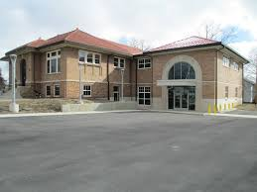
Part 2: Historic Preservation Guidelines
Recommends appropriate building materials, accessories, and alterations for Waterloo’s historic buildings, including:
Architectural Styles
Setbacks
Building Materials
HVAC
Heights
Environment
Renovating, Demolishing

Slide 79
 | Acceptable Types | Key Features | Examples in Waterloo
Zoning | Should promote mixed uses in the downtown. MXD and PUD zoning | Retail, office, recreation and community facilities. | Local Business Zone C-LB (DeKalb County)
Architectural styles for downtown buildings | Revival Styles, Neo-Traditional, Craftsman | Cohesive to existing surrounding buildings, including proportions, materials, windows, doors, and decorative elements | 200 block of Wayne Street, Grant Township Public Library, Waterloo Train Depot
Setback requirements | 0’ setbacks for urban corridor zoning | Buildings abutt sidewalks, creation of a “street wall” | North Wayne Street between Marion and East VanVleek Streets
Building materials | Natural elements, especially brick | Consistency with original brick in Downtown Waterloo | The reddish-brown brick used on the 200 block of N Wayne Street
Building heights | Building height shall be contingent to the surrounding buildings, but shall not exceed three floors, or around 30’ | Two to three floors of mixed use, consistent with the surrounding buildings | Street wall on the 200 block of Wayne Street
Windows and doors | Compliance with original size of buildings, glass wall on the first floor, front door slightly recessed for an entryway. Dark-colored casings add depth to the building. | Should open onto the street to help keep an eye on the street. Zero gradient entryways for doors. Awnings are acceptable for shade. | Baker Insurance Building (250 N. Wayne) has appropriately sized windows on the second floor. The Old Town Hall Building has appropriately sized windows and use of awning.
Landscaping | Use of planters, hanging plants, and other raised gardens in compliance with 0’ setbacks | Planters, native plants, hanging baskets, a plan to maintain landscaping | Landscaping elements at the Waterloo Train Depot
Sidewalks | All downtown streets should provide sidewalks to support walking and increase foot traffic to downtown businesses as well as include safety features for pedestrians, ADA accessibility | Provide sidewalks, street trees, awnings, places to sit, and barriers for pedestrians (on-street parking, planters, etc). | Wide sidewalks on Wayne Street, ADA-compliant ramps at the Waterloo Train Depot, benches at the Eagle Scout Project park
Parking | Decrease the amount of surface parking | Leverage and support shared parking and on-street parking for downtown businesses. | Angled parking on West Wayne Street
Street furniture | Provide amenities along sidewalks such as bike racks, street lamps, and public art to make sidewalks more appealing for pedestrians. | Convenience for bikers, pedestrians, or other modes of alternate transportation | Bike racks and benches at library, planters near Wayne and VanVleek

Slide 80
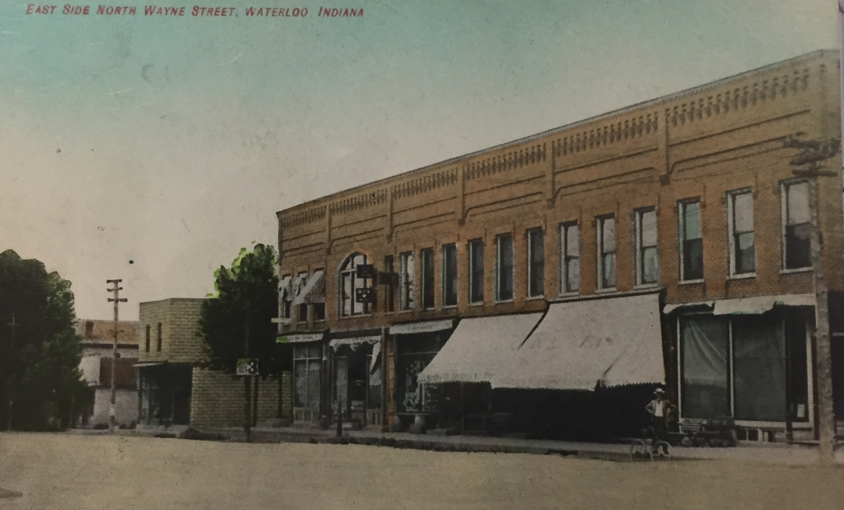
Part 2: Historic Preservation Guidelines

Slide 81
Goals
Maintains or improves character and heritage of Waterloo
Guarantees appropriate development of downtown
Assures walkability

Slide 82
Cost, Partners, and Priority
Project Component | Community Partner(s) | Funding Source | Priority
Urban Corridor Zone | Town of Waterloo, DeKalb County Planning, Local downtown stakeholders | No funding necessary | Low
Historic Preservation Guidelines | Office of Community and Rural Affairs, Indiana Landmarks, American Planning Association | Private | Low

Slide 83
Design Projects Summary
Proposed Design Projects
Project/Program | Priority
Streetscaping and Complete Streets | High
Trail Extension and Depot | High
Farmers' Market | High
Summer Movie Nights | High
Community Center | High
Gateway Signage | High
Dog Park | Medium
Public Art | Medium
Community Swimming Pool & Splash Pad | Low

Slide 84
Policy Programs Summary
Proposed Policy Programs
Project/Program | Priority
Capital Improvement Plan | High
Existing Building Reuse Program | High
Grocery Store/Restaurant Incentive Program | High
Permit and Utility Fee Waiver Program | High
Revolving Loan Fund | High
Public-Private Partnership Program | High
Restaurant Incubator Space | Medium
Business Incubator Space | Low
Venture Capital Fund | Low

Slide 85
Regulatory Programs Summary
Proposed Regulatory Programs
Project/Program | Priority
Sign Ordinance | Low
Urban Corridor Zoning Ordinance | Low
Historic Preservation Guidelines | Low

Slide 86
Questions?

